Slide 1
Persecution: An Opportunity for Total Self-Giving
Pam Arlund, PhD
All Nations International
Perspectives Global

Slide 2
Why do we talk about persecution?
1 Keep on loving each other as brothers and sisters. 3 Remember those in prison, as if you were there yourself. Remember also those being mistreated, as if you felt their pain in your own bodies.
Hebrews 13:1,3 (NLT)

Slide 3
Why do we talk about persecution?
…as if you felt their pain in your own bodies. (NLT)
…imagine you are there with them. (CEV)
…since you yourselves also are in the body. (NASB)
Hebrews 13:3c

Slide 4
Perhaps there is something deeper we can learn (than admiration or guilt)…
Total Self-Giving
Mark 12:30 (NIV)
Love the Lord your God with all your heart and with all your soul and with all your mind and with all your strength.’

Slide 5
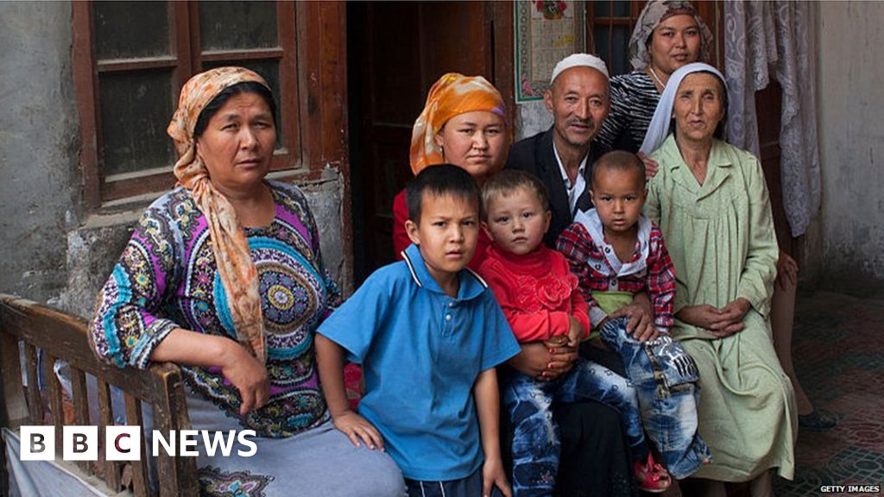
Uyghurs - China

Slide 6
Revelation 12: 11 (NIV)
They triumphed over him by
the blood of the Lamb and
by the word of their testimony;
they did not love their lives so much
as to shrink from death.

Slide 7
Revelation 12: 11 (NIV)
They triumphed over him by
the blood of the Lamb and
by the word (logos) of their testimony (martyr);
they did not love their lives so much
as to shrink from death.

Slide 8
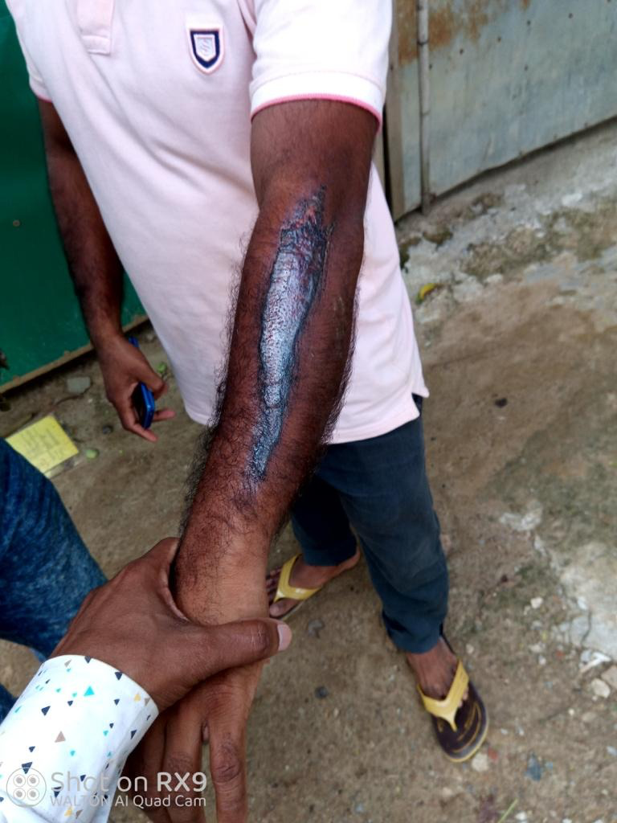
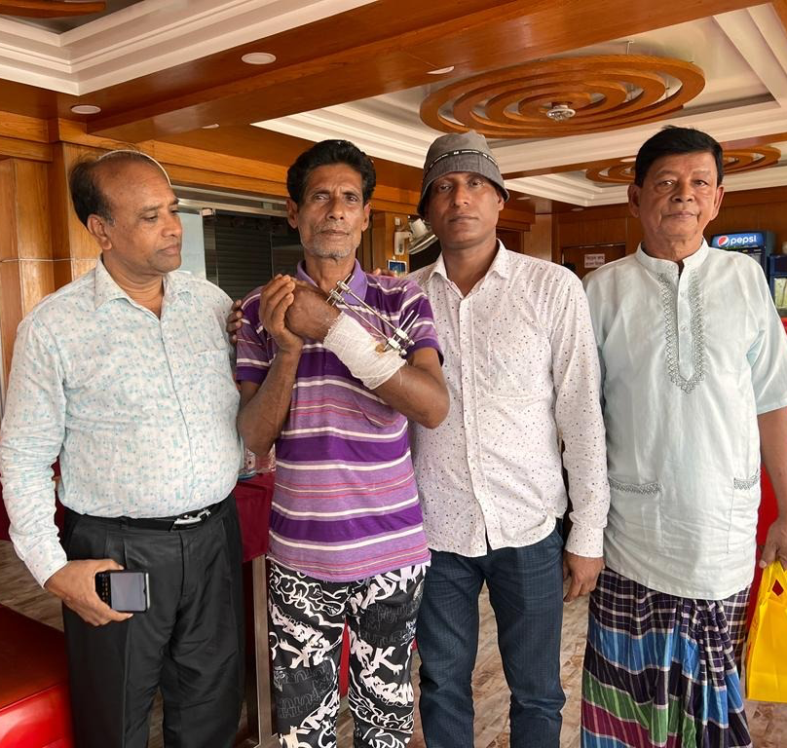
Bangladesh

Slide 9
1 Peter 1:23-25
23 For you have been born again, not of perishable seed, but of imperishable, through the living and enduring word of God.
24 For,
“All people are like grass,
and all their glory is like the flowers of the field;
the grass withers and the flowers fall,
25 but the word of the Lord endures forever.”
And this is the word that was preached to you.

Slide 10
How Should We Respond?
Total Self-Giving
Mark 12:30 (NIV)
Love the Lord your God with all your heart and with all your soul and with all your mind and with all your strength.’

